Slide 1
Goal Setting
SACHIN RAJBHAR

Slide 2
Goals
What are they?
Why use them?
How do you write them?

Slide 3
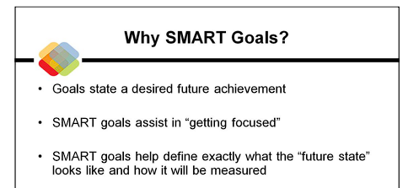

Slide 4
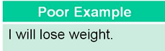
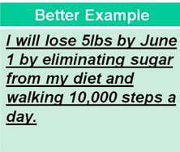
Specific
Whom?
1
Measurable
How Much?
2
Attainable
Clear?
3
Result- Oriented
Realistic?
4
Time Bound
Deadline?
5

Slide 5

Q
You give specifications to your
Train/Flight ticket for 500km
like your place, timing, platform
Life is a long Journey
No Specifications at all
Why?
Why???

Slide 6
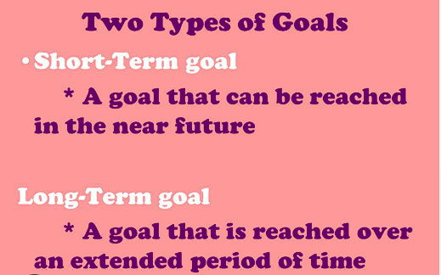








Slide 7
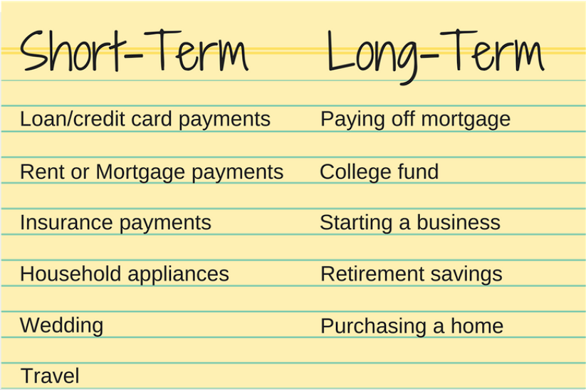

Slide 8
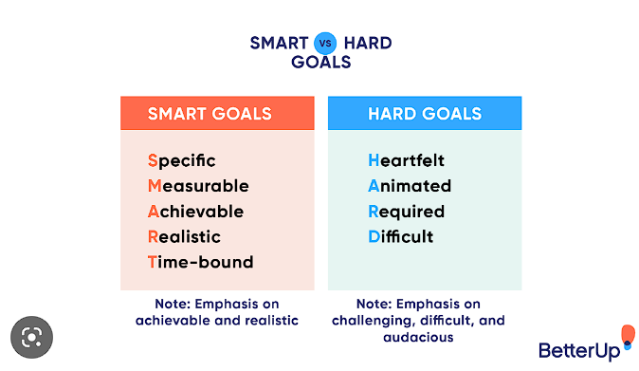

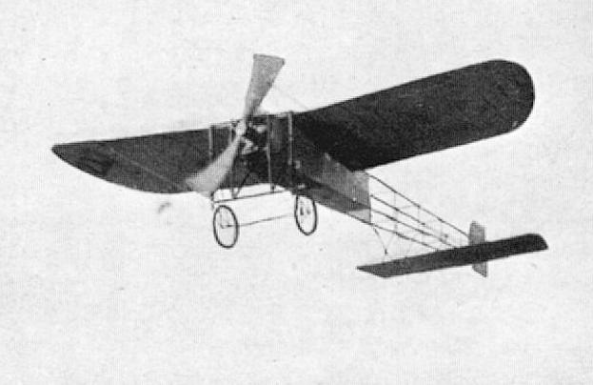
Practicing a
10 on 10 shots in DARTS in 1 week
Wright Brothers:
Invented Airplane on Dec 17, 1903

Slide 9
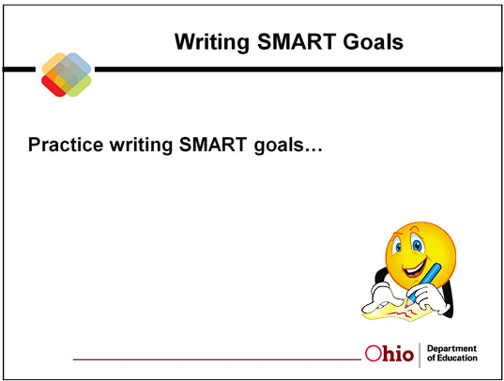

Slide 10
Thank you
Sachin Rajbhar
officialsachinrajbhar@gmail.comaquagaming.com
REFRENCES:
huronhs.com
Google.com
Sandeep Maheshwari

